Slide 1
Real Estate Housing Price Prediction
657 Final Project
By Group 11: Jack Hausler, Sakhi Namireddy, Ashwin Shandilya, and Naser Muraduzzaman

Slide 2
Scenario Explanation
We are real estate investors, looking for properties to invest in that would have the highest return on investment (ROI), but we have not used a machine learning model to advise investments before.
In order to effectively do so, we want to make a model that has:
The ability to identify factors that are important to consider for investment decisions
Can identify which properties are listed below market value (properties that would generate high ROI)

Slide 3
Business Question
Can property investors accurately predict
the expected selling price of a home that
is to be sold and identify which features of a
home are most important to consider when
investing in order to make more profitable
investments?

Slide 4
Competitive Advantage
The model aims to enable investors to predict real estate investments that will have a profitable return on investment, giving investors in the market an advantage over their competitors
💵
$

Slide 5
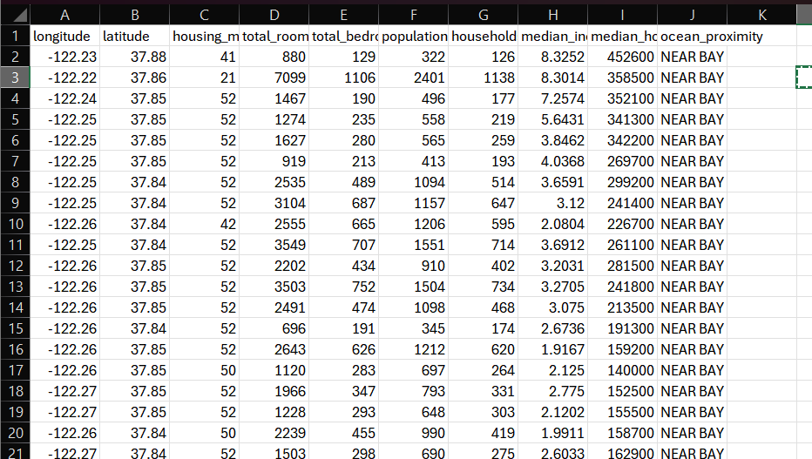
Dataset Description
20640 Rows
10 Columns:
This dataset is a modified version of the California Housing dataset, it was built using the 1990 California census data
It contains one row per census block group
A block group is the smallest geographical unit for which the U.S. Census Bureau publishes sample data
A block group typically has a population of 600 to 3,000 people

Slide 6
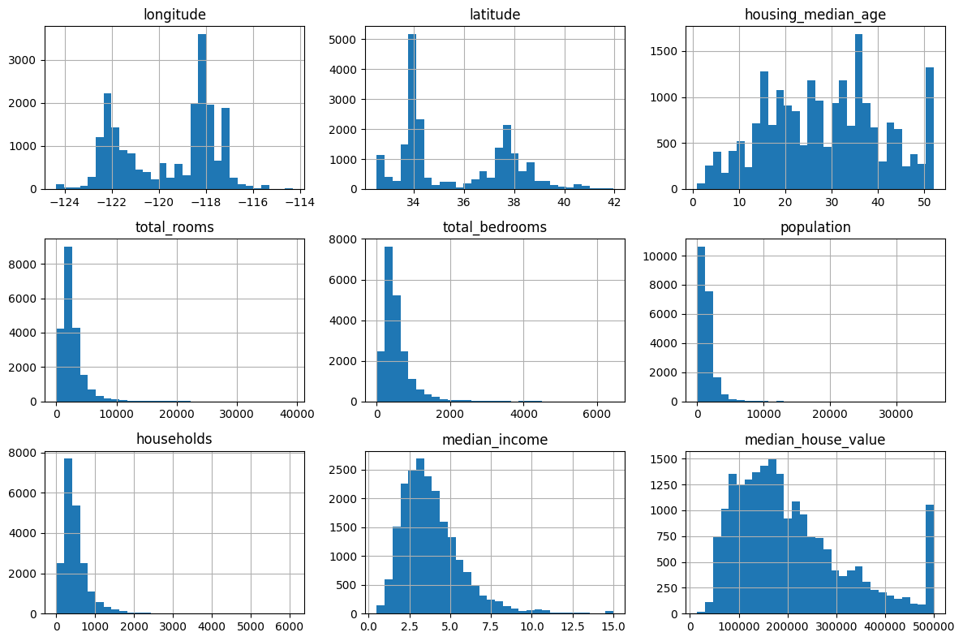
Initial Data Inspection

Slide 7
Initial Data Inspection
Data Information:
<class 'pandas.core.frame.DataFrame'>
RangeIndex: 20640 entries, 0 to 20639
Data columns (total 10 columns):
# Column Non-Null Count Dtype
--- ------ -------------- -----
0 longitude 20640 non-null float64
1 latitude 20640 non-null float64
2 housing_median_age 20640 non-null float64
3 total_rooms 20640 non-null float64
4 total_bedrooms 20433 non-null float64
5 population 20640 non-null float64
6 households 20640 non-null float64
7 median_income 20640 non-null float64
8 median_house_value 20640 non-null float64
9 ocean_proximity 20640 non-null object
Missing Values:
longitude 0
latitude 0
housing_median_age 0
total_rooms 0
total_bedrooms 207
population 0
households 0
median_income 0
median_house_value 0
ocean_proximity 0
dtype: int64

Slide 8
Eliminating Non-Null Values
The only missing values were in the total_bedrooms variable, containing 207 null cells
These null values were replaced with the average of the present values of the column

Slide 9
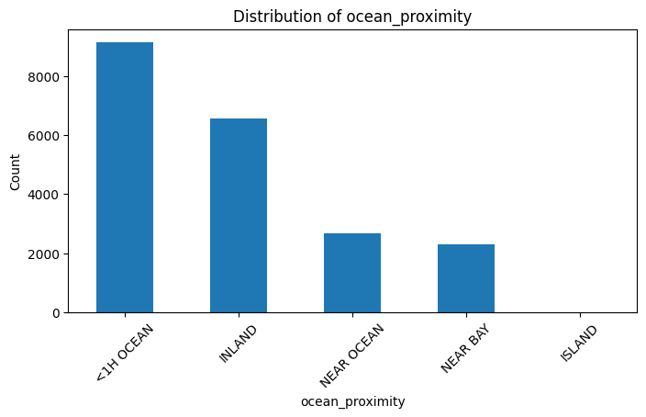
Object to Numeric Conversion
Converting ocean_proximity to dummy variables broken down into:
ocean_<1H OCEAN
ocean_INLAND
ocean_ISLAND
ocean_NEAR BAY
ocean_NEAR OCEAN

Slide 10
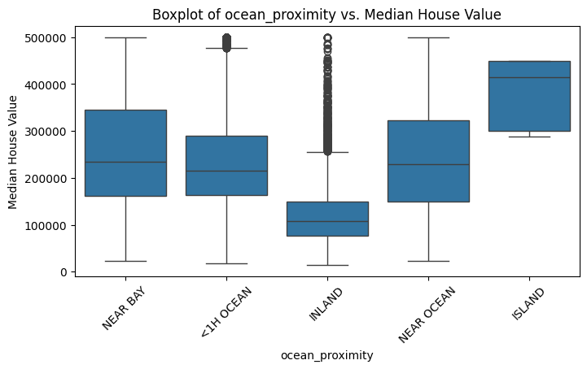
Data Exploration
Business Takeaways:
Houses near the ocean/on an island are much more expensive than homes further inland
Decision between which type of home to invest in
Investors with high-end clientele should look at ocean properties
More expensive up-front
Investing in homes inland are more low-stakes investments
Less initial expense

Slide 11
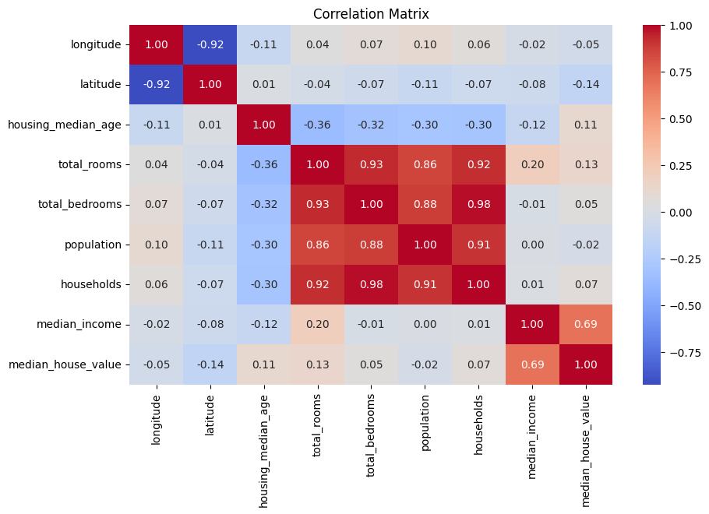
Multicollinearity
Positive Correlation: total_rooms, total_bedrooms, population and households are highly correlated among each other, median_income and median_house_value show a 69% positive correlation
Negative Correlation: longitude and latitude show strong negative correlation of around 92%

Slide 12
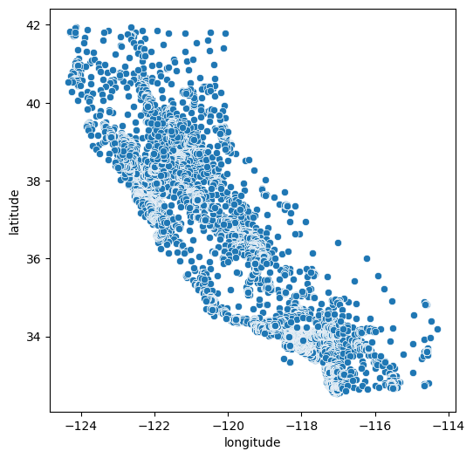
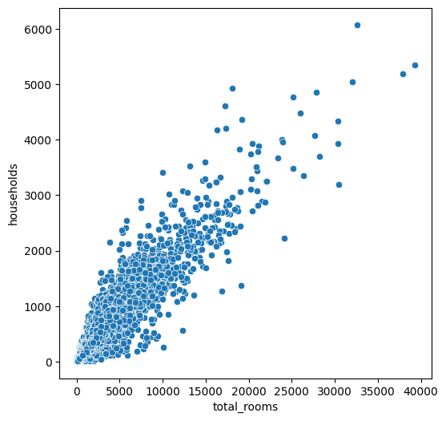
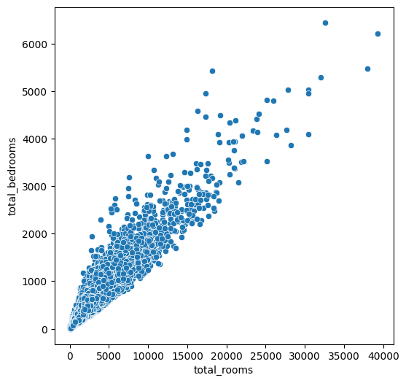
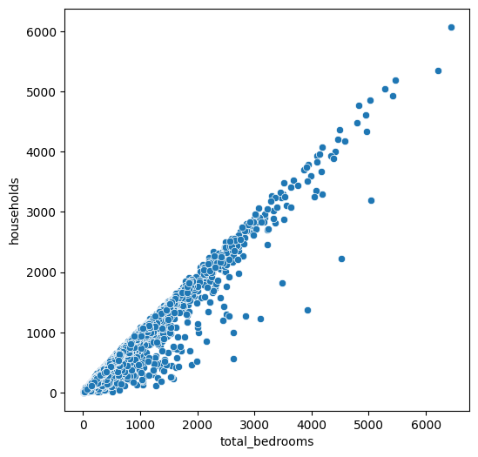
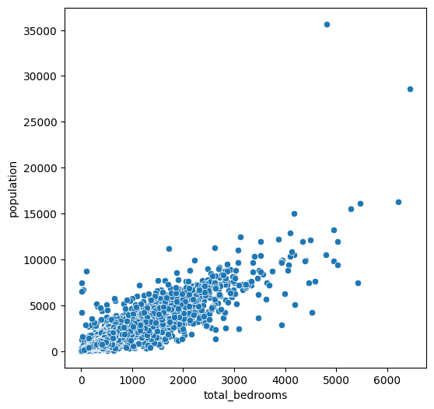
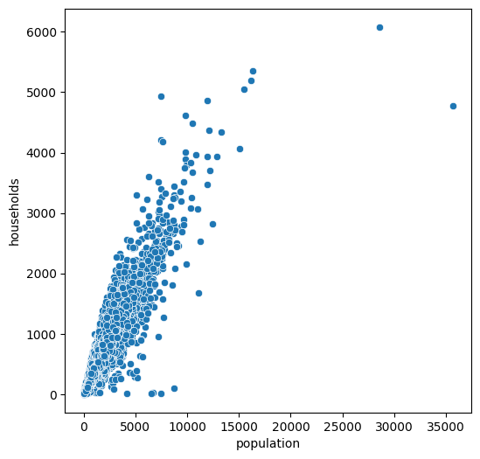
Multicollinearity
Correlation: -0.92
Correlation: 0.92
Correlation: 0.93
Correlation: 0.98
Correlation: 0.88
Correlation: 0.91

Slide 13
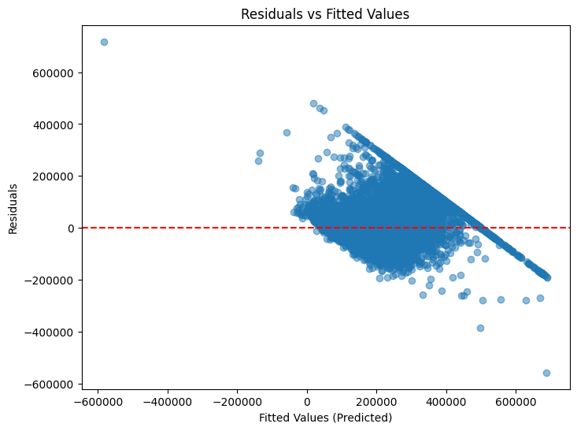
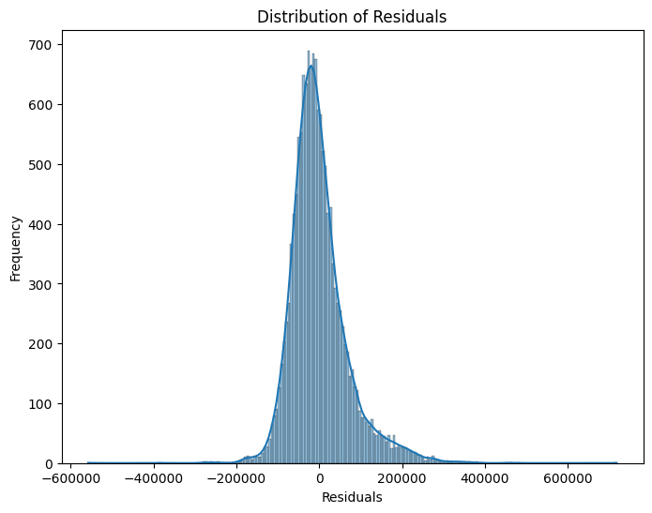
Checking Model Assumptions
VIF
Heteroscedasticity
Normality of Error Terms
feature VIF
0 const 1.000000
3 housing_median_age 1.327650
8 median_income 1.773794
6 population 6.081233
4 total_rooms 12.758394
1 longitude 17.991314
2 latitude 19.882770
7 households 33.617752
5 total_bedrooms 35.563718
feature VIF
0 const 1.000000
7 ocean_ISLAND 1.000921
9 ocean_NEAR OCEAN 1.135653
5 median_income 1.291098
2 housing_median_age 1.310382
1 latitude 1.516395
8 ocean_NEAR BAY 1.523210
6 ocean_INLAND 1.675823
4 population 4.265448
3 total_rooms 4.542881

Slide 14
Exploratory Analysis - Results
Converted Ocean Proximity into dummy values
Checked Multicollinearity of variables
Verified VIF values
Used the previous 2 metrics to remove specific columns

Slide 15
Model Types
As real estate investors with little coding experience, we chose to look at 2 models to compare which one performs the best:
Linear Regression and Random Forest to predict Median House Values

Slide 16
Model Performance Metrics
Mean Absolute Error (MAE)
Mean Squared Error (MSE)
Root Mean Squared Error (RMSE)
R Squared (R²)

Slide 17
Linear Regression
70% training, 15% validation, 15% test
Utilization of simple linear regression to predict the target variable (median_house_value)
RMSE is around 68000
The model is able to explain around 66% of variance in the house prices as depicted by R^2
The model is well generalized as there’s no overfitting and the training and test values are almost identical.
Training Set Performance:
MAE: 49868.11
MSE: 4755931815.55
RMSE: 68963.26
R^2 Score: 0.64
Validation Set Performance:
MAE: 49863.88
MSE: 4684330553.19
RMSE: 68442.17
R^2 Score: 0.65
Test Set Performance:
MAE: 49422.12
MSE: 4543997466.73
RMSE: 67409.18
R^2 Score: 0.66

Slide 18
Random Forest
Utilization of Random Forest Regression to predict the target variable and compare performance against linear regression
Model explains about 65 - 69% variance in house prices as indicated by the R^2 value.
Model is also well generalized as there’s very minimal differences between the test and training data.
Training Data Performance:
Mean Squared Error: 4644026364.005899
Root Mean Squared Error: 68147.09358443615
R^2 Score: 0.6513886513388131
MAE: 48832.80850343002
Test Data Performance:
Mean Squared Error: 4828645012.060216
Root Mean Squared Error: 69488.45236483696
R^2 Score: 0.6372242477690271
MAE: 49870.95344205144

Slide 19
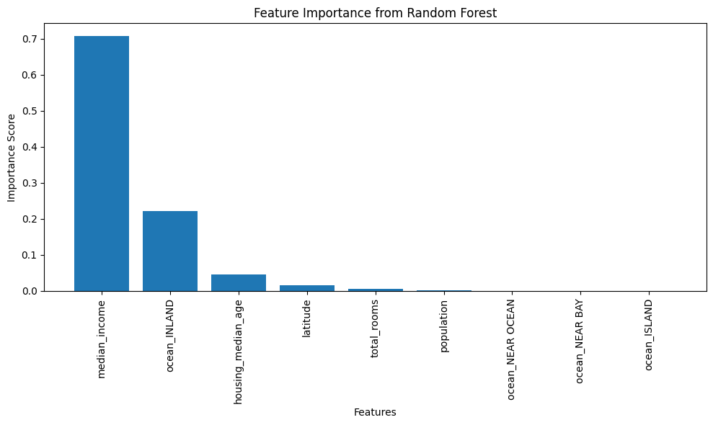
Random Forest - Feature Importance

Slide 20
Model Evaluation
Evaluate model performance metrics between the two models to determine which is superior
Visual Evaluation: Feature importance plot for interpretability

Slide 21
Performance and Concerns
Performance nearly identical between the two models
Both Models perform fairly well
Concerns: Outdated 1990 data raises concerns about current and future applicability of the model

Slide 22
Model Selection
We chose to select the Linear Regression model
Slightly outperforms the Random Forest Model across all metrics

Slide 23
Improvements
Elimination of Null Values
Standardization of numerical features using Standard Scaler to reduce bias
Dropping high multicollinearity columns such as ‘total_bedrooms’, ‘households’, 'ocean_<1H OCEAN', 'longitude' (based on VIF)

Slide 24
Overall Model Performance
R² Score: 0.64
MAE: 49433.12
Key Takeaway:
The model performs well and has good generalizing capabilities, making it a solid baseline for predicting the median house values

Slide 25
Overfitting: Training vs Testing Performance
Luckily, our model did not suffer from overfitting
Linear Regression R^2 improves from 0.64 to 0.66 on testing vs training data
Random Forest R^2 improves from 0.63 to 0.65 on testing vs training data

Slide 26
Business Recommendations
Prioritize investing in homes based on investor’s intuition
Close to ocean = high volatility, larger ROI
Inland = stable, but smaller ROI
Compare predicted price from model to actual listing price to find homes that are listed under their predicted value to be able to sell for profit
Check generalizability of model on more recent data in order to make more accurate predictions
Inflation and economic shifts have reshaped the real estate market
Compare home price predictions from model to 1990 interest and inflation rates to forecast the growth in price for 2025

Slide 27
THANK YOU!

